Slide 1

Introduction to Bluetooth
By Sanjay and Arvind Seshan

Slide 2
Objectives
Learn how to use the Bluetooth functionality on your EV3
Learn to send and receive messages between EV3 bricks

Slide 3
What is Bluetooth?
Bluetooth uses radio frequencies to communicate between devices
The EV3 uses Bluetooth to download programs wirelessly
The EV3 also uses Bluetooth to connect to another EV3

Slide 4
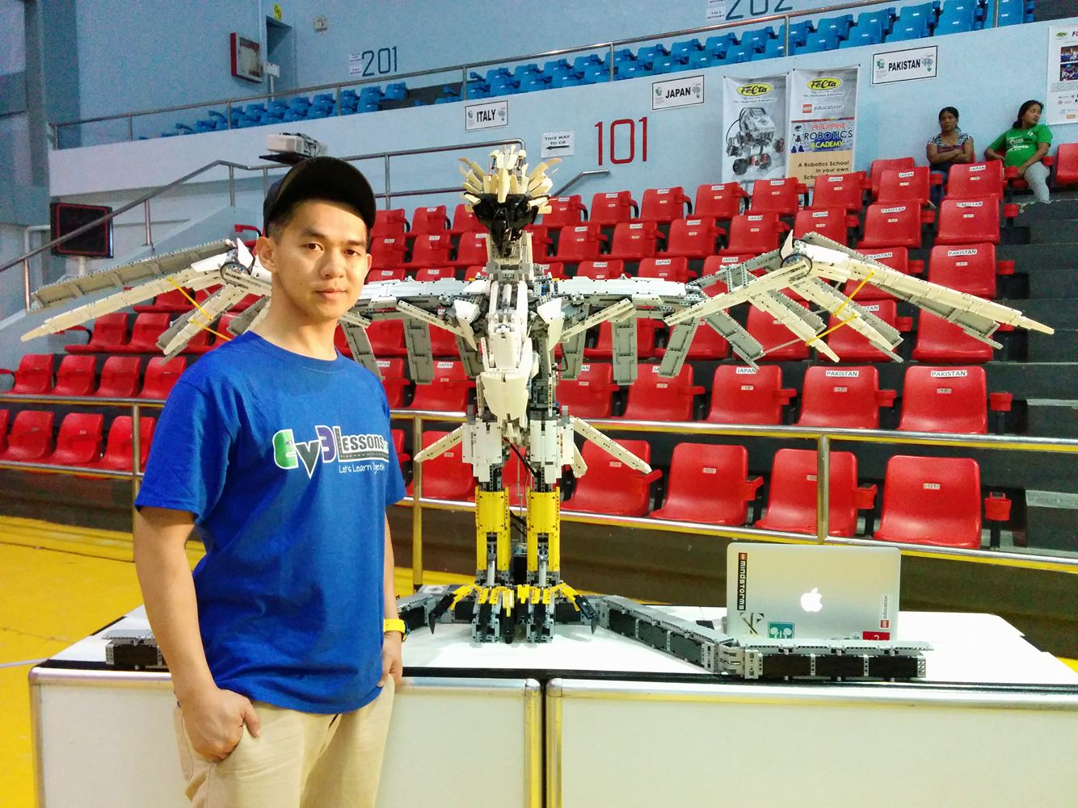
Why Use Bluetooth on the EV3?
Controlling a large single robot with multiple bricks
An alternative to daisy chaining: Requires less wiring but needs separate programs
Coordinating multiple robots
Have them perform similar actions
Synchronize their actions

Slide 5
Tips for Success
Give each brick an unique name (Sender and Receiver for this lesson)
Use an USB cable for downloading code to the bricks (rather than Bluetooth). You cannot connect between EV3s and a PC at the same time
Turn on the receiver robot first then the sender in the challenges in this lesson. This is because the challenge solution only sends the message once in Challenge 1.

Slide 6
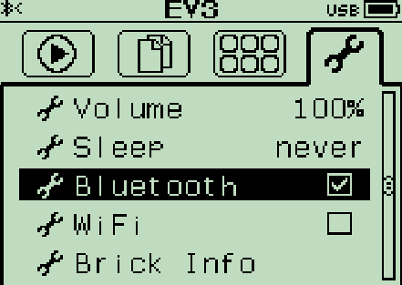
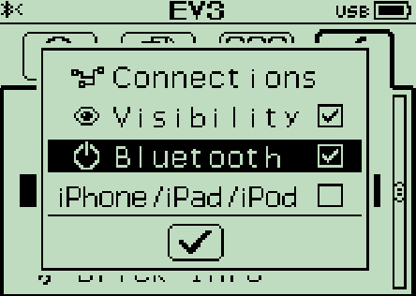
Activating Bluetooth on the EV3
Turning on Bluetooth:
On the EV3 menu, go to the symbol that looks like a wrench
Go down to the word “Bluetooth” and activate it
To connect to another brick go back into the Bluetooth menu
Go to “Connections”
Select “Search” and find the other brick’s name
You can also manage your connections with the Bluetooth Connection Block. But we do not use this block in this lesson.

Slide 7
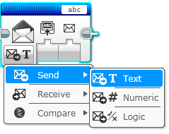
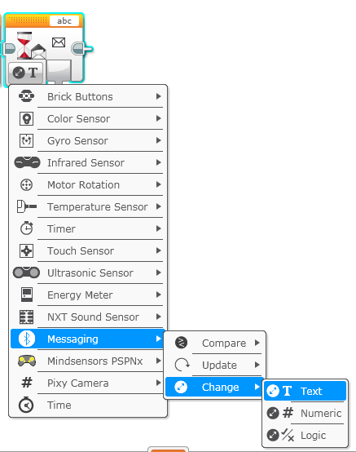
New Block: Messaging
The messaging block can be found in the Blue Pallet.
You will also use the Wait For block in Messaging Mode

Slide 8
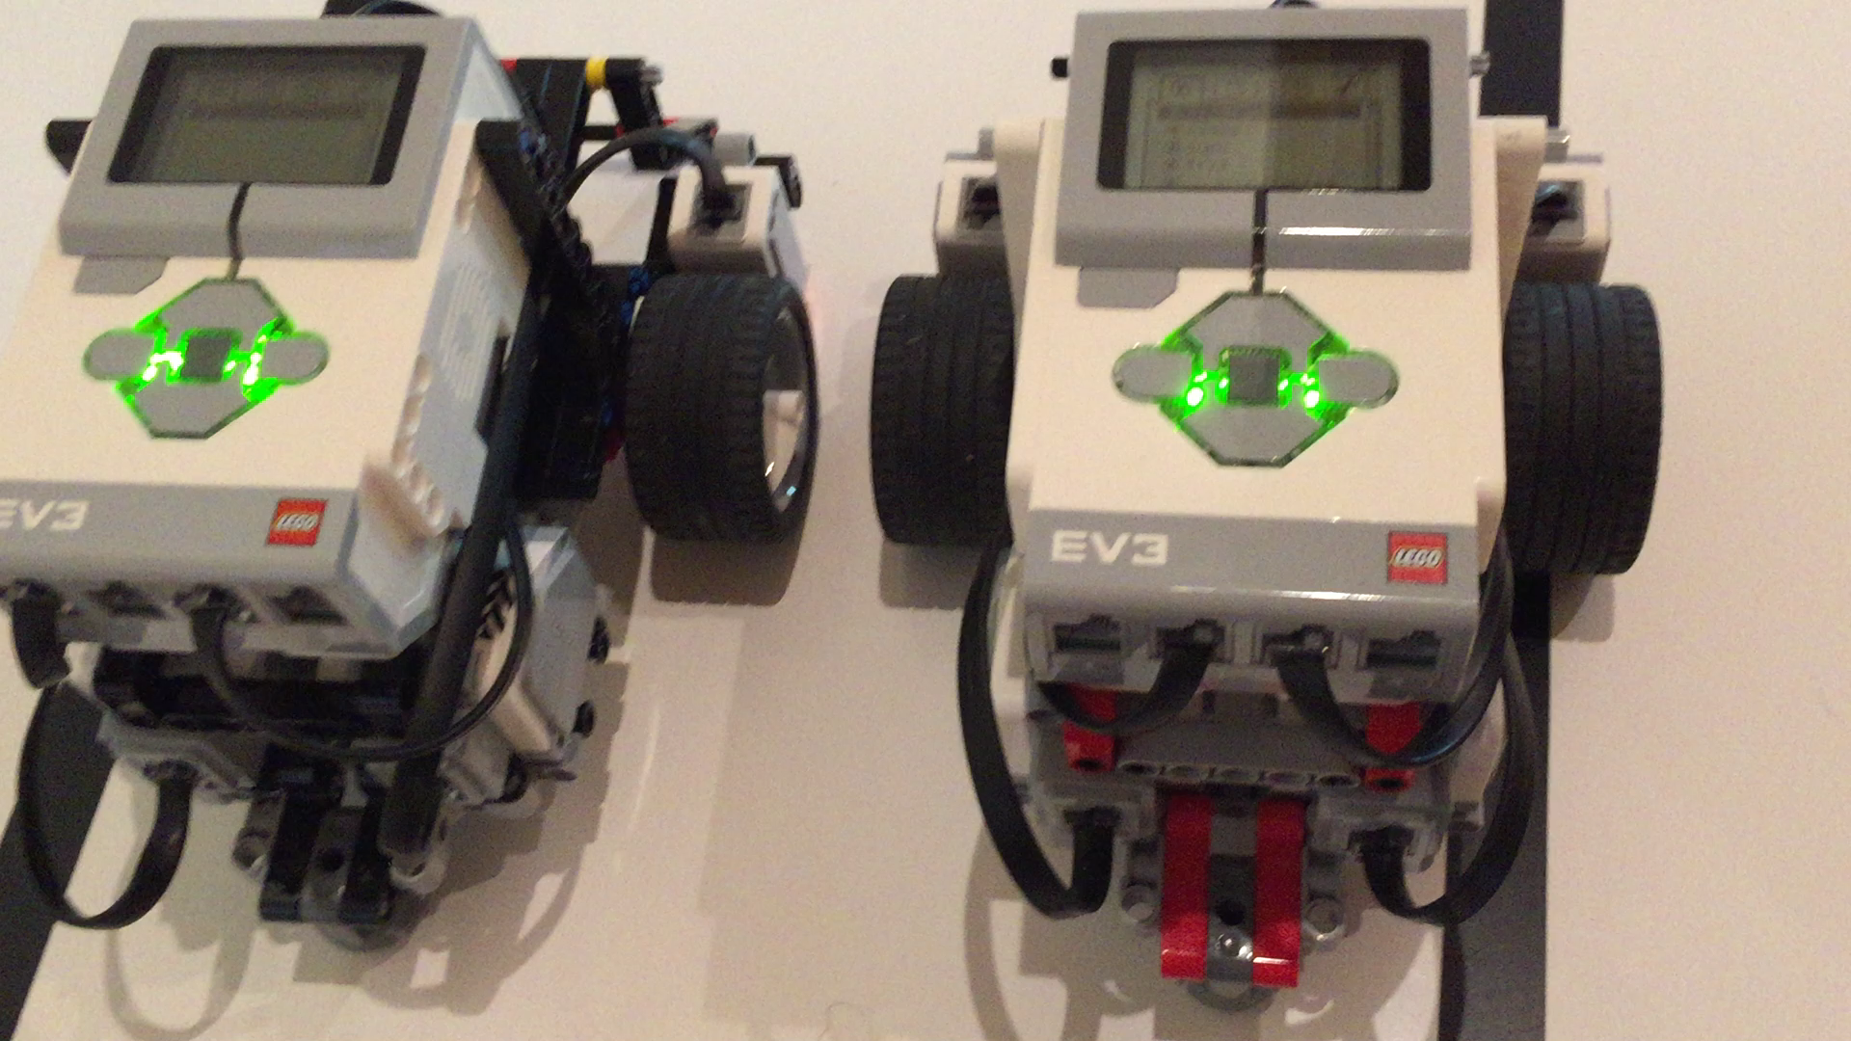
Challenge 1
Send a “Hello World” message from one brick to another
The second brick should receive and display the message on its screen for 5 seconds
Tips:
You will need to pair the two robots ahead of time
Name one robot Sender and the other Receiver for this challenge
For this challenge, you will use the Messaging block → Send → Text
You will use the Wait For block in the Messaging Mode → Change → Text
Video

Slide 9
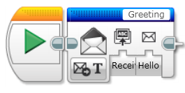
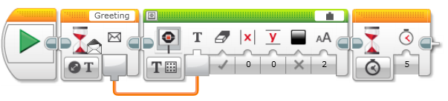
Challenge 1 Solution
Sends the message “Hello World” to the Receiver robot. The message title “Greeting” must match in the receiver’s program.
Code on the Sender Robot
Wait for a message from the first robot and display the text for 5 seconds
Code on the Receiver Robot

Slide 10
Challenge 2: Synchronized Swimmers
Move the first robot by hand and send the motors’ power to the other robot
Have the second brick receive the data and copy the movement

Slide 11
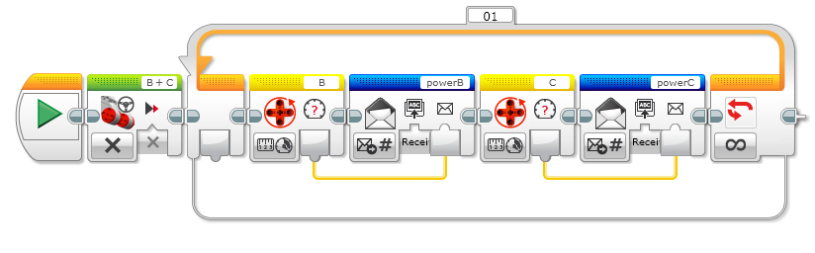
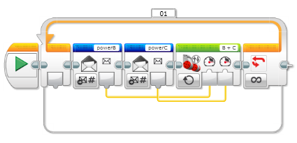
Challenge 2 Solution
Read each of the motors’ power and send them using two different message titles to the Receiver robot
Code on the Sender Robot
Code on the Receiver Robot
Read the two different message titles and apply the received power values

Slide 12
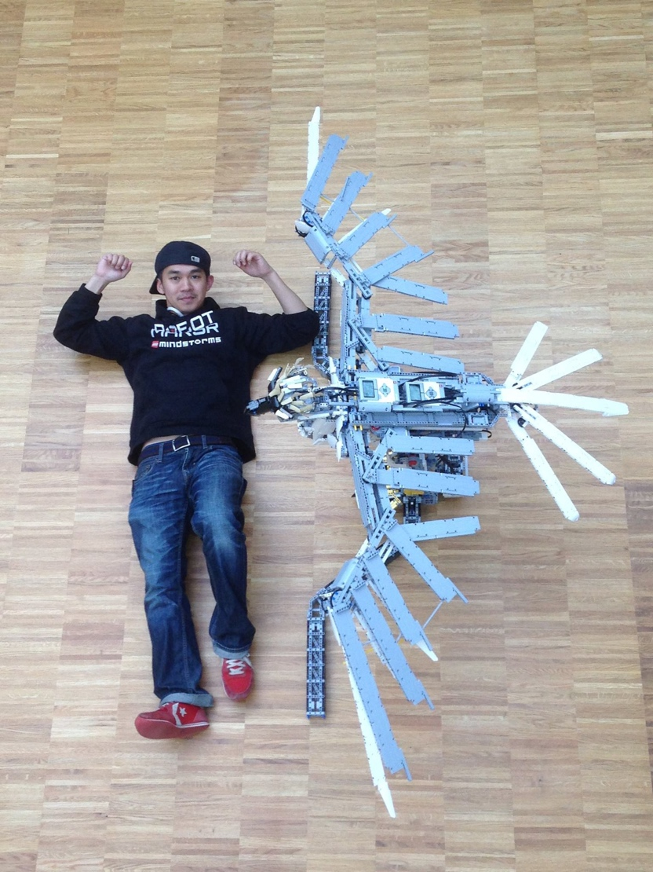
Putting it all Together
Once you know how to use Bluetooth on the EV3, you can create complex robots where movement is coordinated and synchronized
Master Lee Magpili’s Eagle is an example of such a project where Bluetooth messages are used to coordinate head, leg and wing movement. (Photos and code posted with permission.) Another brick uses Bluetooth to remotely control the Eagle.
This project requires the following parts for the bird and a remote:
5 EV3s
17 Motors
2 Touch Sensors

Slide 13
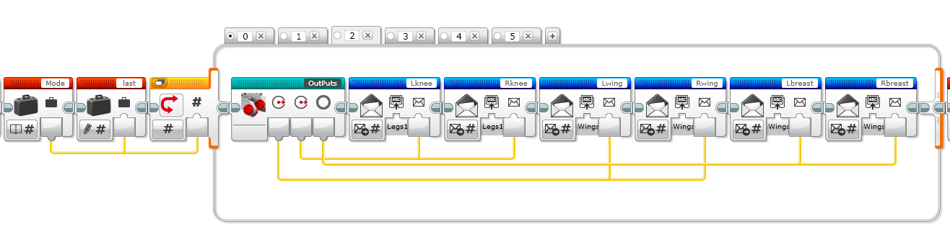
The Eagle
This is small part of the Eagle’s code. Here you see that the Eagle has five modes. In this view, you see that messages are being sent to “Legs1” and “Wings” EV3 bricks.
Thank you to Master Lee Magpili for sharing his code with EV3Lessons.

